Slide 1
DataBase with PostgreSQL

Slide 2
1st first quality of database is to permit storage of good data, data which are needed for application program
2nd second quality of database is to do not permit storage of bad data

Slide 3
Constraint!
Integrity Constraint is a condition specified on a database schema and restricts the data that can be stored in an instance of the database.
specified when we define database schema, database structure
enforced when update data, DataBase Management System checks for violations and disallows changes to data that violates constraints specified

Slide 4
In some situations, rather than disallow change (RESTRICT), the DBMS might make some compensating changes to data to ensure that database instance satisfies all integrity constraints
changes to database are not allowed to create instance that violates any constraint

Slide 5
Declarative
integrity constraint can be arbitrary predicate pertaining to database

Slide 6
part of database schema design process and declared as part of create table / alter table

Slide 7
Constraints on a Single Relation
Primary Key
not null
unique
check(<predicate>)

Slide 8
Not NULL Constraint
restrict the domain of attributes to exclude null values, by declaring it
for example,
name varchar(50) not null

Slide 9
Unique Constraint
SQL supports a unique integrity constraint: unique (A_{j1}, A_{j2}, … A_{jm})specification says that attributes A_{j1}, A_{j2}, … A_{jm} form a superkey, that is, no two tuples in relation can be equal on all listed attributes
attributes declared as unique are permitted to be null unless they have explicitly been declared to be not null
  recall that null value does not equal any other value

Slide 10
Check Constraint
clause check(P) specifies a predicate P that must be satisfied by every tuple in relation – row in table
for example, clause check(price > 0) in create table command for relation / table would ensure that the value of price is nonnegative
check (season in ('Fall', 'Winter', 'Spring', 'Summer'))
check clause constraint permits attribute domains to be restricted in powerful ways that most programming language data type systems do not permit

Slide 11
constraints may appear on its own or as part of declaration of an attribute
constraints on value of single attribute are listed with that attribute, while more complex clauses are listed separately at the end of a create table statement

Slide 12
Referential Integrity
ensure that a value that appears in one relation (the referencing relation) for given set of attributes also appears for certain set of attributes in another relation (the referenced relation)
referential integrity constraints, Foreign Keys are a form of a referential integrity constraint where referenced attributes form a Primary Key of the referenced relation

Slide 13
SQL also supports a version of the references clause where a list of attributes of the referenced relation can be specified explicitly; the specified list of attributes must, however, be declared as a super-key of the referenced relation, using a unique constraint
Foreign Key must reference a compatible set of attributes, that is, the number of attributes must be the same and the data types of corresponding attributes must be compatible

Slide 14
when a referential-integrity constraint is violated, normal procedure is to reject – RESTRICT - the action that caused the violation
a Foreign Key clause can specify that if delete or update action on the referenced relation violates the constraint, then, instead of rejecting action, system must take steps to change the tuple in referencing relation to restore the constraint

Slide 15
create table department (
dept_name varchar (20),
building varchar (15),
budget numeric (12,2) check (budget > 0),
primary key (dept_name));
create table course (
course_id varchar (8),
title varchar (50),
dept_name varchar (20),
credits numeric (2,0) check (credits > 0),
primary key (course_id),
foreign key (dept_name) references department
on delete cascade
on update cascade );

Slide 16
CHECK Constraint

Slide 17
in DBeaver right-click on table and then you can activate the option to Generate SQL for table’s DDL Data Definition Language

Slide 18
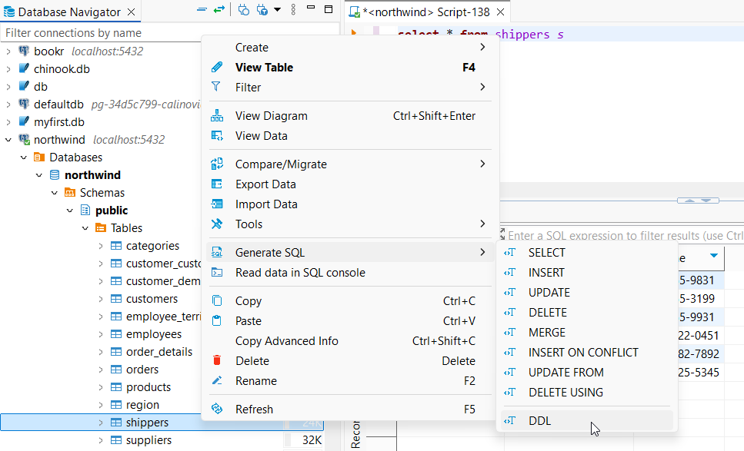

Slide 19
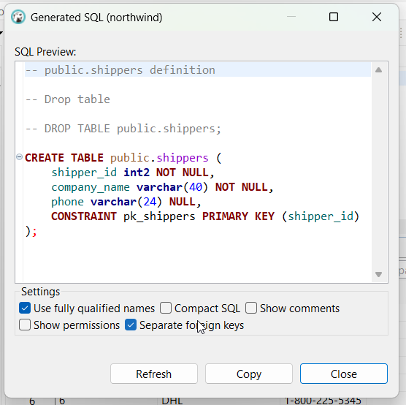

Slide 20
CREATE TABLE public.shippers (
shipper_id int2 NOT NULL,
company_name varchar(40) NOT NULL,
phone varchar(24) NULL,
CONSTRAINT pk_shippers PRIMARY KEY (shipper_id));
attribute company_name is NOT NULL – no reason to store information about unknown shipping company and phone is character string () and NULL – because it is possible to do not know the phone number

Slide 21
improvement maybe, can enforce the uniqueness of company_name in relation shippers
after the table is already created, possible to add unique constraint to an existing column or group of columns by creating a unique index based on column or group of columns

Slide 22
update products set unit_price = -21 where product_id = 2
we like to be customer of such e-commerce company
we do not like to be teacher who sign on database topic of engineer who allows this
data type enforced by DBMS is numeric - clearly the domain of attribute it is positive numbers

Slide 23
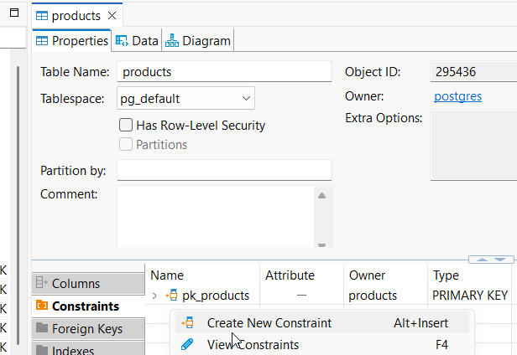

Slide 24
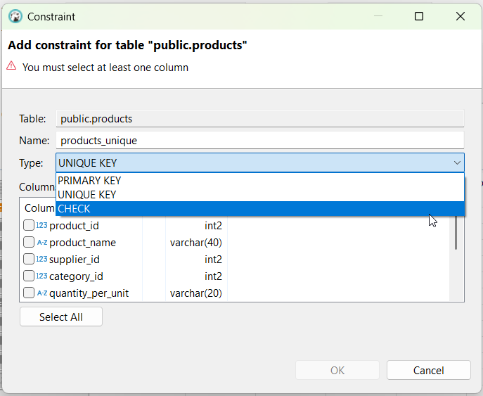

Slide 25
ALTER TABLE public.products ADD CONSTRAINT products_check CHECK (unit_price > 1);

Slide 26
Working with images
table categories have a category_id attribute, a category name and description and the last attribute is the picture
in the picture column right-click Edit and then Load from file

Slide 27
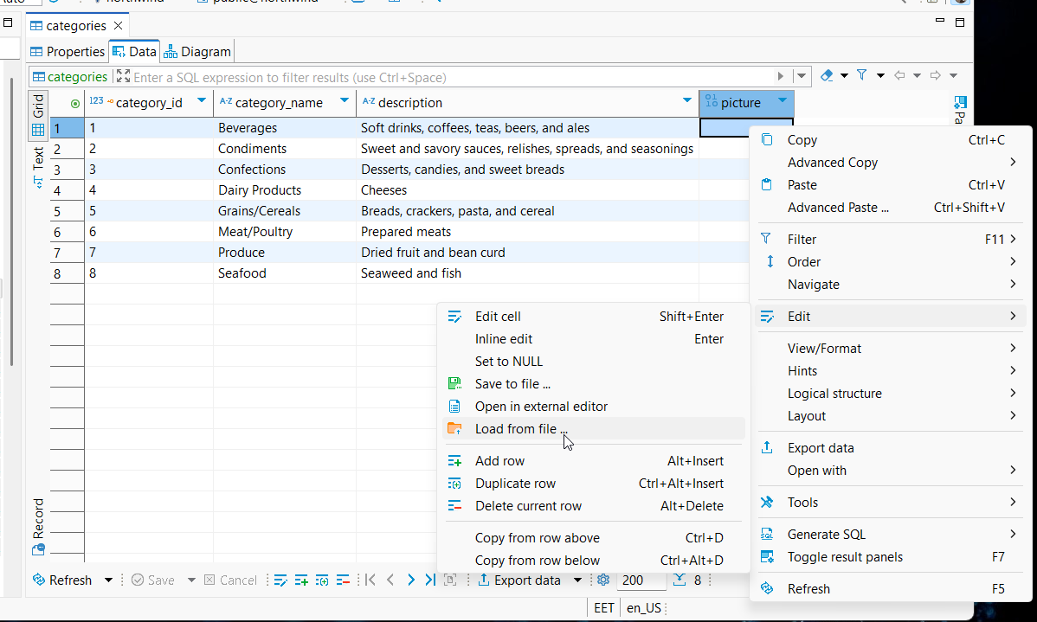

Slide 28
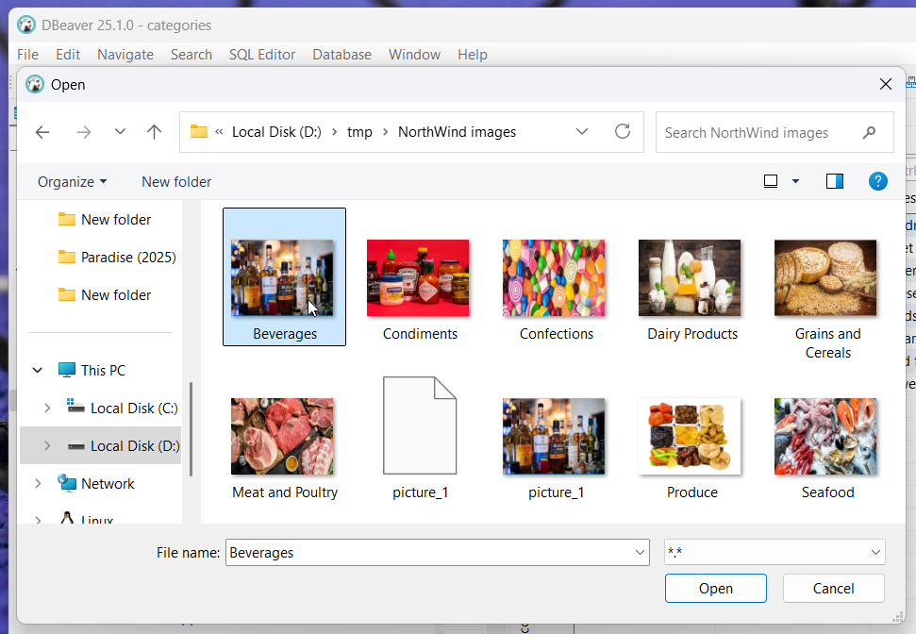
browse and select file

Slide 29
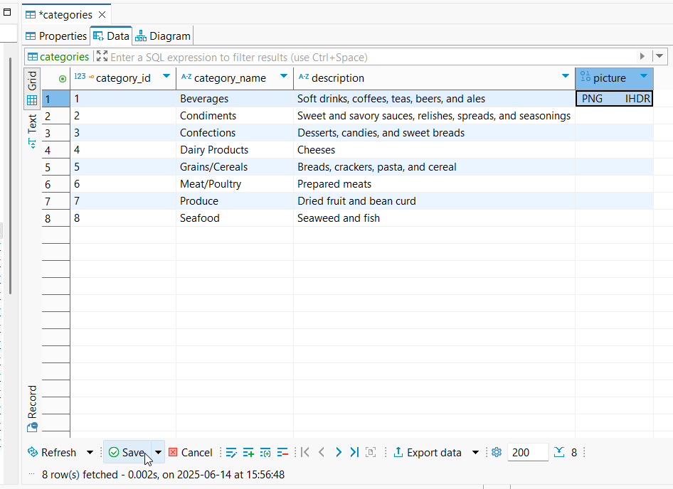
Save

Slide 30
in addition to general data formats, DBeaver offers specialized support for large text and Binary Large OBject BLOB data types
Edit CLOB/BLOB data: Editing cells containing CLOB/BLOB data in the Cell Editor opens the content in a new tab, allowing for comprehensive editing, particularly useful for large data objects
Saving/Loading BLOB values: Users can save and load BLOB values to and from external files, aiding management of binary data like images and large text files
Image display in BLOB Columns: DBeaver automatically renders images stored in BLOB columns (formats like gif, png, jpeg, bmp) within the interface, streamlining the process of viewing image data
Value View panel: To efficiently browse images in BLOB columns, users can activate the value view panel by pressing F7

Slide 31
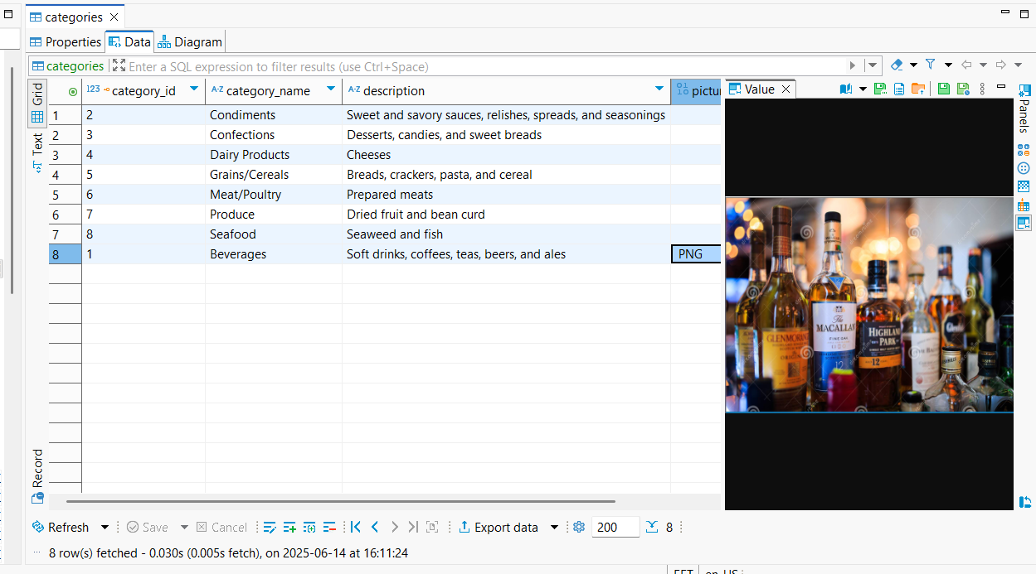

Slide 32
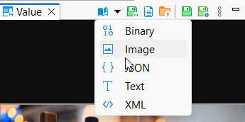
Tool bar
Content viewer settings:

Slide 33
Transform into a serial
Postgres database table with integer ID field (Primary Key) which currently contains unique sequential integers starting at 1 into a 'serial'

Slide 34
select * from region r;
CREATE SEQUENCE region_region_id_seq;
ALTER TABLE region ALTER COLUMN region_id SET DEFAULT nextval('region_region_id_seq');
ALTER SEQUENCE region_region_id_seq OWNED BY region.region_id;
SELECT MAX(region_id) FROM region
SELECT setval('region_region_id_seq', 4); -- 4 was the result returned by SELECT MAX(region_id) FROM region
-- testing
INSERT INTO region (region_description) VALUES('My New Region');

Slide 35
Self Join
self-join is a regular join, but the table is joined with itself:
SELECT column_name(s)
FROM table1 T1, table1 T2
WHERE condition;
table employees have a report_to attribute, a Foreign Key matching the Primary Key employee_id from the same table

Slide 36
select
e.employee_id, e.title_of_courtesy, e.first_name, e.last_name, e.title,
m.employee_id as manager_empoyee_id, m.title_of_courtesy as manager_title_of_courtesy,
m.first_name as manager_first_name, m.last_name as manager_last_name, e.title as manager_title
from employees e left outer join employees m
on e.reports_to = m.employee_id
Dr. Andrew Fuller Vice President, Sales has no other employee to report to – It’s good to be a king!

Slide 37
Views
it is not always desirable for all users to see the entire set of relations in the database
security system of a DataBase Management System based on SQL authorization mechanism can restrict access to relations
security considerations may require that only certain data in a relation be hidden from a user
Always build Views!

Slide 38
SQL allows a “virtual relation” to be defined by a query, and the relation conceptually contains the result of the query
virtual relation is not precomputed and stored but instead is stored precompiled, optimized and computed by executing query whenever the virtual relation is used

Slide 39
create view employees_with_managers as
select e.employee_id, e.title_of_courtesy, e.first_name, e.last_name, e.title, e.birth_date, e.hire_date,
e.address, e.city, e.region, e.postal_code, e.country, e.home_phone, e."extension", e.photo, e.photo_path, e.notes,
e.reports_to, m.first_name || ' ' || m.last_name as manager
from employees e left outer join employees m
on e.reports_to = m.employee_id;

Slide 40
select * from employees_with_managers
CRUD operations made on employees relation table will be automatically reflected in the employees_with_managers view
View names may appear in query any place where relation table name may appear

Slide 41
Exercise
improve the Northwind database by adding constraints and checking these constraints
improve the Northwind database by adding views and testing these views

Slide 42
implement a database about movies similar to IMDb
https://www.imdb.com/
fill the database with data – use Mockaroo - Random Data Generator and API Mocking Tool | JSON / CSV / SQL / Excel
https://mockaroo.com/

Slide 43
there were 42 slides in presentation so far …

Slide 44
The Answer to
Ultimate Question of Life, the Universe, and Everything?

Slide 45


Slide 46


